Slide 1
Guaranteed Contraction Control in the Presence of Imperfectly Learned Dynamics
Pan Zhao, Ziyao Guo, Yikun Cheng, Aditya Gahlawat and Naira Hovakimyan
University of Illinois at Urbana Champaign, Urbana, IL 61820
Submitted to TRASE-2022 Workshop, Feb 28, 2022

Slide 2
Motivation
Planning and executing a trajectory is one of the most common ways for a robot or autonomous systems (ASs) to achieve a mission.
Dynamic uncertainties and disturbances, together with the nonlinear dynamics, bring significant challenges to safely plan and execute a trajectory.
For model-based learning control with safety and/or performance guarantees, researchers have largely relied on Gaussian process regression (GPR) due to the inherent ability to quantify the uncertainties in the prediction of the learned model.
Wind

Slide 3
Statement of Contribution
We propose a trajectory-centric learning control framework that allows for the use of DNNs (and many other ML tools) to learn uncertain dynamics while still providing transient tracking performance guarantees, including the case of no learning.
Our approach provides exponential convergence to the desired trajectory throughout the learning phase, even when the learned model is poor.
With improved accuracy, the learned model can help optimize other performance criteria, e.g., energy consumption, beyond trajectory tracking.

Slide 4

Learning Control Framework
Design a feedback control law to track the planned trajectory with guaranteed tracking performance throughout the learning phase.
Use DNNs to learn the uncertainty and incorporate the learned model in planning desired trajectories to minimize specific cost functions subject to constraints.
Enhance the performance, i.e., reducing the costs associated with the actual control and state trajectories, through improved quality of the learned uncertainty model.

Slide 5
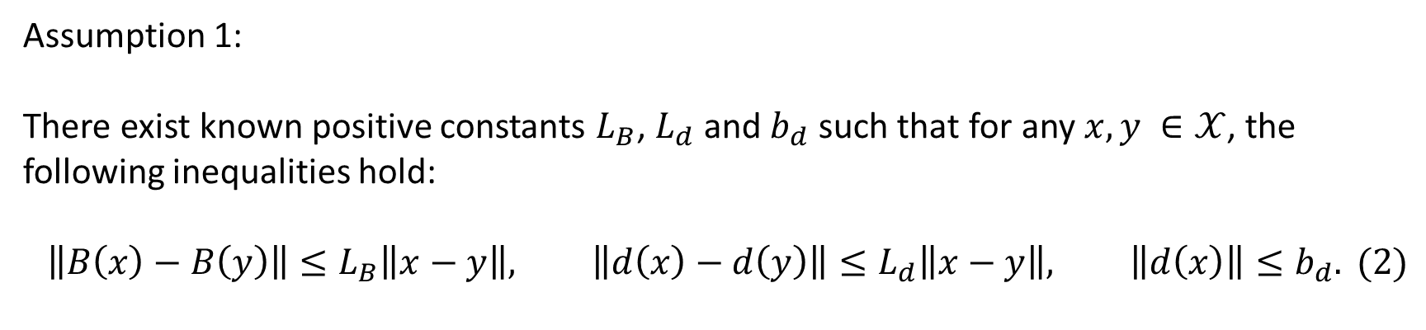
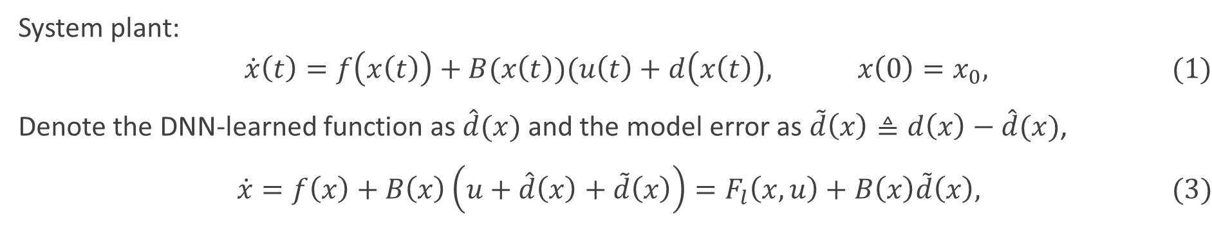
Problem Statement
System plant:
$$\dot{x}\left(t\right)=f\left(x\left(t\right)\right)+B(x\left(t\right))(u\left(t\right)+d\left(x\left(t\right)\right), x\left(0\right)=x_{0}, (1)$$
Denote the DNN-learned function as $\hat{d}(x)$ and the model error as $\tilde{d}\left(x\right)≜d\left(x\right)−\hat{d}(x)$,
$\dot{x}=f\left(x\right)+B\left(x\right)\left(u+\hat{d}\left(x\right)+\tilde{d}\left(x\right)\right)=F_{l}\left(x,u\right)+B\left(x\right)\tilde{d}\left(x\right), (3)$
Assumption 1:
There exist known positive constants $L_{B}$, $L_{d}$ and $b_{d}$ such that for any $x, y ∈𝒳$, the following inequalities hold:
$$\left\|B\left(x\right)−B\left(y\right)\right\|≤L_{B}\left\|x−y\right\|, \left\|d\left(x\right)−d\left(y\right)\right\|≤L_{d}\left\|x−y\right\|, \left\|d\left(x\right)\right\|≤b_{d}. (2)$$

Slide 6
Preliminaries
Spectral Norm DNN, CCM, Riemannian Energy

Slide 7
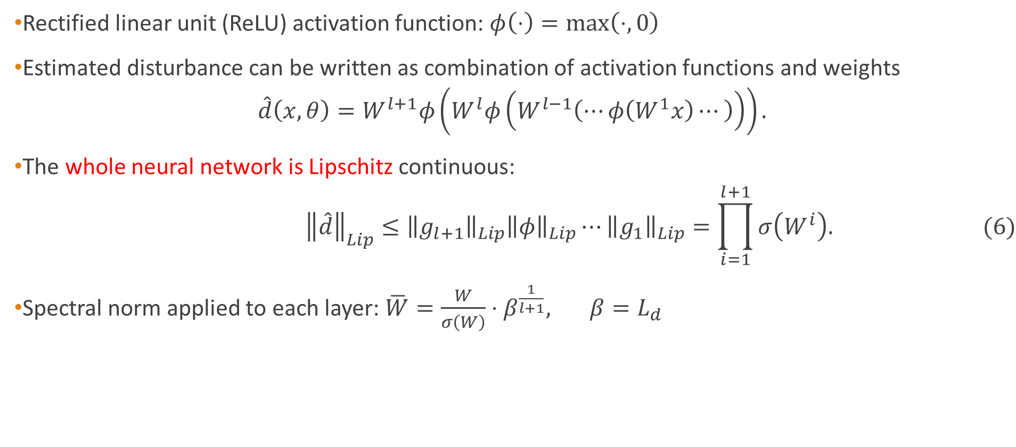
DNNs with Spectral Normalization (SN)
Rectified linear unit (ReLU) activation function: $φ\left(⋅\right)=max\left(⋅,0\right)$
Estimated disturbance can be written as combination of activation functions and weights
$$\hat{d}\left(x,θ\right)=W^{l+1}φ\left(W^{l}φ\left(W^{l−1}\left(⋯φ\left(W^{1}x\right)⋯\right)\right)\right).$$
The whole neural network is Lipschitz continuous:
$${\left\|\hat{d}\right\|}_{Lip}≤{\left\|g_{l+1}\right\|}_{Lip}{\left\|φ\right\|}_{Lip}⋯{\left\|g_{1}\right\|}_{Lip}=\prod_{i=1}^{l+1}{σ\left(W^{i}\right).} (6)$$
Spectral norm applied to each layer: $\overline{W}=\frac{W}{σ\left(W\right)}⋅β^{\frac{1}{l+1}}, β=L_{d}$
Notes:
ReLU: Rectified Linear Unit

Slide 8
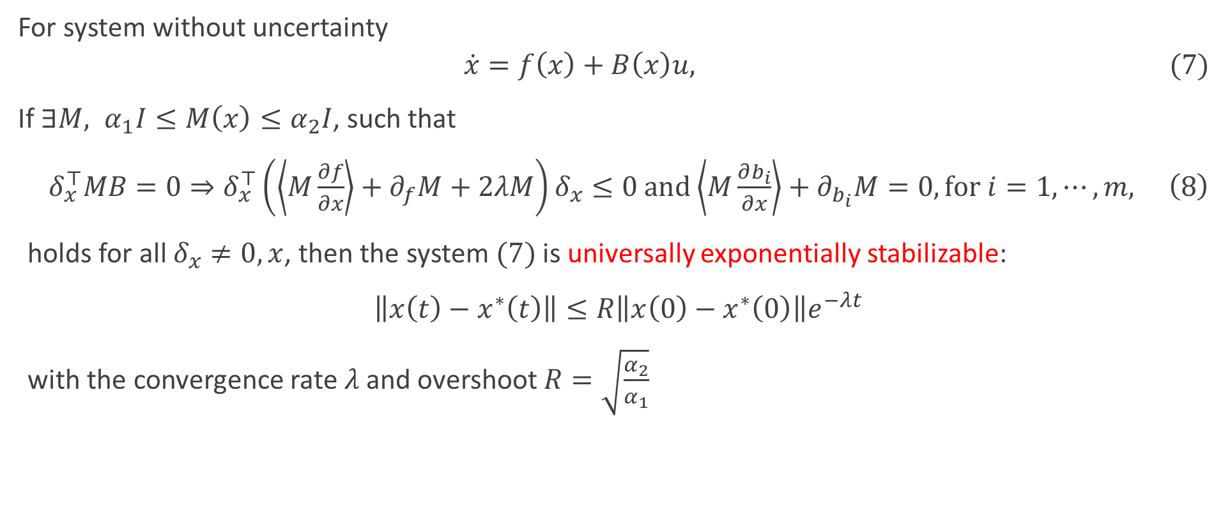

$$\text{Control} \text{Contraction} \text{Matrice}{\text{s}}^{∗}$$
For system without uncertainty
$$\dot{x}=f\left(x\right)+B\left(x\right)u, (7)$$
If $∃M, α_{1}I≤M\left(x\right)≤α_{2}I$, such that
$δ_{x}^{⊤}MB=0⇒δ_{x}^{⊤}\left(\left\langle M\frac{∂f}{∂x}\right\rangle +∂_{f}M+2λM\right)δ_{x}≤0 \text{and}\left\langle M\frac{∂b_{i}}{∂x}\right\rangle +∂_{b_{i}}M=0, \text{for} i=1,⋯,m, \left(8\right)$
holds for all $δ_{x}≠0, x$, then the system $(7)$ is universally exponentially stabilizable:
$\left\|x\left(t\right)−x^{∗}\left(t\right)\right\|≤R\left\|x\left(0\right)−x^{∗}\left(0\right)\right\|e^{−λt}$
with the convergence rate $λ$ and overshoot $R=\sqrt{\frac{α_{2}}{α_{1}}}$

Slide 9
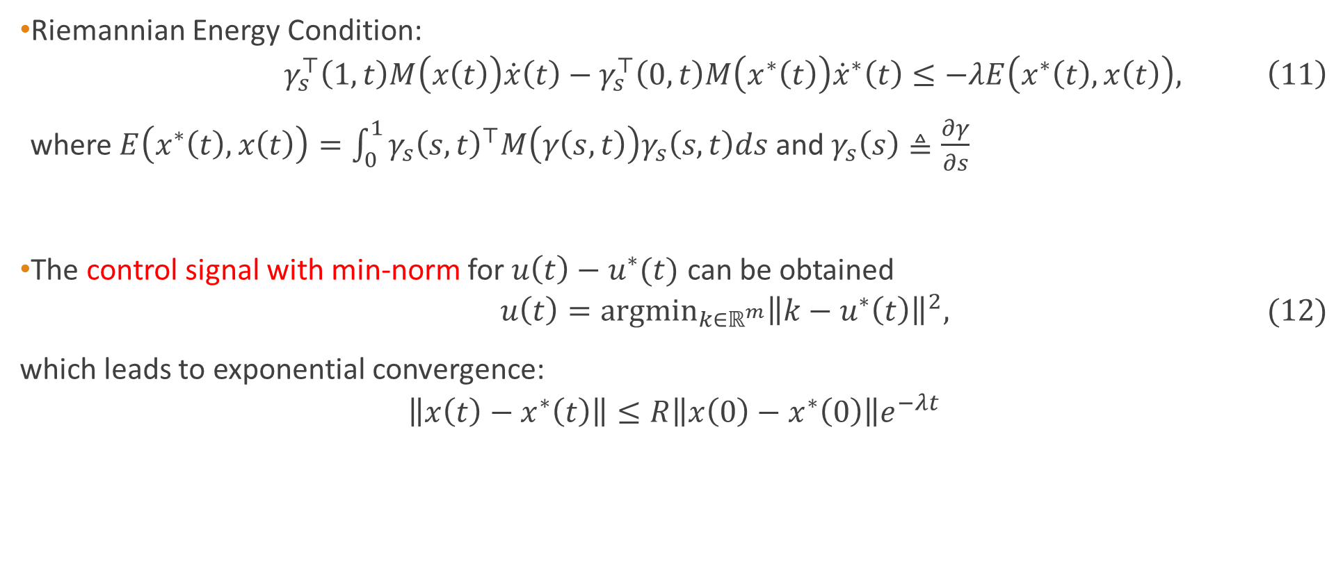
QP with Riemannian Energy Condition
Riemannian Energy Condition:
$$γ_{s}^{⊤}\left(1,t\right)M\left(x\left(t\right)\right)\dot{x}\left(t\right)−γ_{s}^{⊤}\left(0,t\right)M\left(x^{∗}\left(t\right)\right){\dot{x}}^{∗}\left(t\right)≤−λE\left(x^{∗}\left(t\right),x\left(t\right)\right), \left(11\right)$$
where $E\left(x^{∗}\left(t\right),x\left(t\right)\right)=\int_{0}^{1}{γ_{s}{\left(s,t\right)}^{⊤}M\left(γ\left(s,t\right)\right)γ_{s}\left(s,t\right)ds}$ and $γ_{s}\left(s\right)≜\frac{∂γ}{∂s}$
The control signal with min-norm for $u\left(t\right)−u^{∗}(t)$ can be obtained
$$u\left(t\right)={\text{argmin}}_{k∈ℝ^{m}}{\left\|k−u^{∗}\left(t\right)\right\|}^{2}, \text{ (12)}$$
which leads to exponential convergence:
$$\left\|x\left(t\right)−x^{∗}\left(t\right)\right\|≤R\left\|x\left(0\right)−x^{∗}\left(0\right)\right\|e^{−λt}$$
Notes:
A geodesic $γ(⋅,t)$ connecting these two states (i.e., $γ\left(0,t\right)=x^{∗}(t)$ and $γ\left(1,t\right)=x(t)$ can be computed.

Slide 10
Robust Contraction Control in the Presence of Learned Dynamics
Robust Riemannian Energy (RRE) and Disturbance Estimation

Slide 11
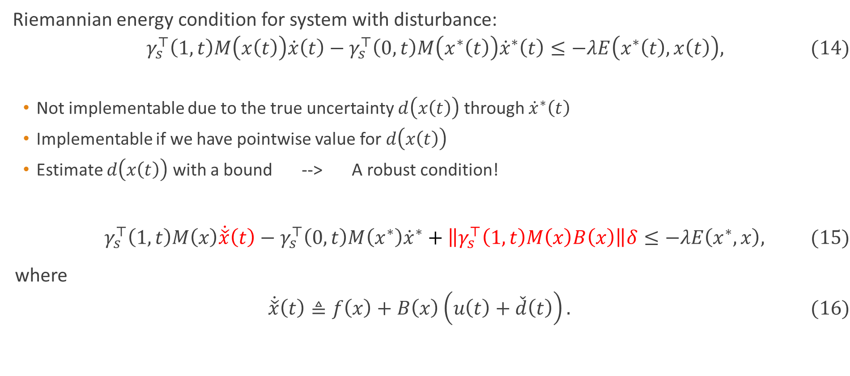
Robust Riemannian Energy Condition
Riemannian energy condition for system with disturbance:
$$γ_{s}^{⊤}\left(1,t\right)M\left(x\left(t\right)\right)\dot{x}\left(t\right)−γ_{s}^{⊤}\left(0,t\right)M\left(x^{∗}\left(t\right)\right){\dot{x}}^{∗}\left(t\right)≤−λE\left(x^{∗}\left(t\right),x\left(t\right)\right), (14)$$
Not implementable due to the true uncertainty $d\left(x\left(t\right)\right)$ through ${\dot{x}}^{∗}\left(t\right)$
Implementable if we have pointwise value for $d\left(x\left(t\right)\right)$
Estimate $d\left(x\left(t\right)\right)$ with a bound --> A robust condition!
$$γ_{s}^{⊤}\left(1,t\right)M\left(x\right)\dot{\check{x}}\left(t\right)−γ_{s}^{⊤}\left(0,t\right)M\left(x^{∗}\right){\dot{x}}^{∗}+\left\|γ_{s}^{⊤}\left(1,t\right)M\left(x\right)B\left(x\right)\right\|δ≤−λE\left(x^{∗},x\right), (15)$$
where
$$\dot{\check{x}}\left(t\right)≜f\left(x\right)+B\left(x\right)\left(u\left(t\right)+\check{d}\left(t\right)\right). (16)$$

Slide 12
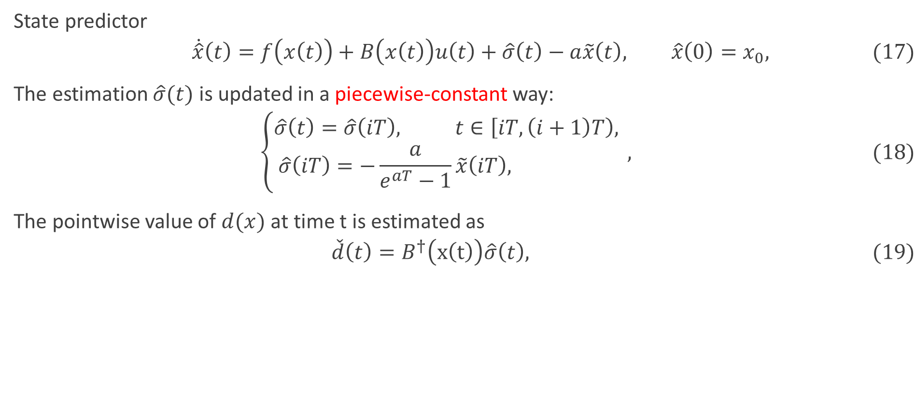
Estimation with Computable EEBs
State predictor
$$\dot{\hat{x}}\left(t\right)=f\left(x\left(t\right)\right)+B\left(x\left(t\right)\right)u\left(t\right)+\hat{σ}\left(t\right)−a\tilde{x}\left(t\right), \hat{x}\left(0\right)=x_{0}, (17)$$
The estimation $\hat{σ}(t)$ is updated in a piecewise-constant way:
$$\left\{\begin{aligned}\hat{σ}\left(t\right)=\hat{σ}\left(iT\right), t∈\left[iT,\left(i+1\right)T\right), \\ \hat{σ}\left(iT\right)=−\frac{a}{e^{aT}−1}\tilde{x}\left(iT\right), \end{aligned}\right., (18)$$
The pointwise value of $d(x)$ at time t is estimated as
$$\check{d}\left(t\right)=B^{†}\left(x\left(t\right)\right)\hat{σ}\left(t\right), (19)$$

Slide 13
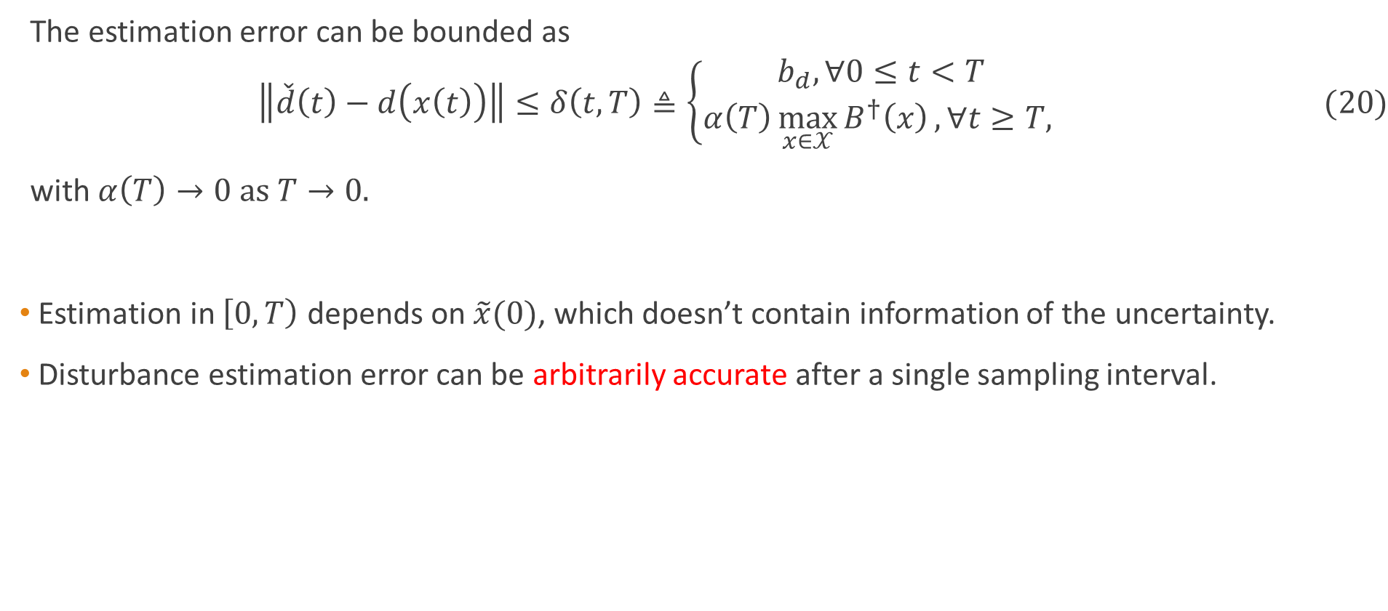
Estimation with Computable EEBs
The estimation error can be bounded as
$$\left\|\check{d}\left(t\right)−d\left(x\left(t\right)\right)\right\|≤δ\left(t,T\right)≜\left\{\begin{aligned}b_{d}, ∀0≤t<T \\ α\left(T\right)\max_{x∈𝒳}{B^{†}\left(x\right)}, ∀t≥T, \end{aligned} \right. (20)$$
with $α\left(T\right)→0 \text{as} T→0.$
Estimation in $\left[0,T\right)$ depends on $\tilde{x}(0)$, which doesn’t contain information of the uncertainty.
Disturbance estimation error can be arbitrarily accurate after a single sampling interval.

Slide 14
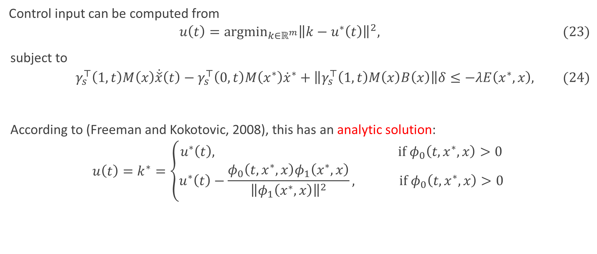
QP with Robust Riemannian Energy Condition
Control input can be computed from
$$u\left(t\right)={\text{argmin}}_{k∈ℝ^{m}}{\left\|k−u^{∗}\left(t\right)\right\|}^{2}, (23)$$
subject to
$$γ_{s}^{⊤}\left(1,t\right)M\left(x\right)\dot{\check{x}}\left(t\right)−γ_{s}^{⊤}\left(0,t\right)M\left(x^{∗}\right){\dot{x}}^{∗}+\left\|γ_{s}^{⊤}\left(1,t\right)M\left(x\right)B\left(x\right)\right\|δ≤−λE\left(x^{∗},x\right), (24)$$
According to (Freeman and Kokotovic, 2008), this has an analytic solution:
$$u\left(t\right)=k^{∗}=\left\{\begin{aligned}u^{∗}\left(t\right), \text{if} φ_{0}\left(t,x^{∗},x\right)>0 \\ u^{∗}\left(t\right)−\frac{φ_{0}\left(t,x^{∗},x\right)φ_{1}\left(x^{∗},x\right)}{{\left\|φ_{1}\left(x^{∗},x\right)\right\|}^{2}}, \text{if} φ_{0}\left(t,x^{∗},x\right)>0\end{aligned}\right.$$

Slide 15
Simulation Results
Planar Rotor

Slide 16
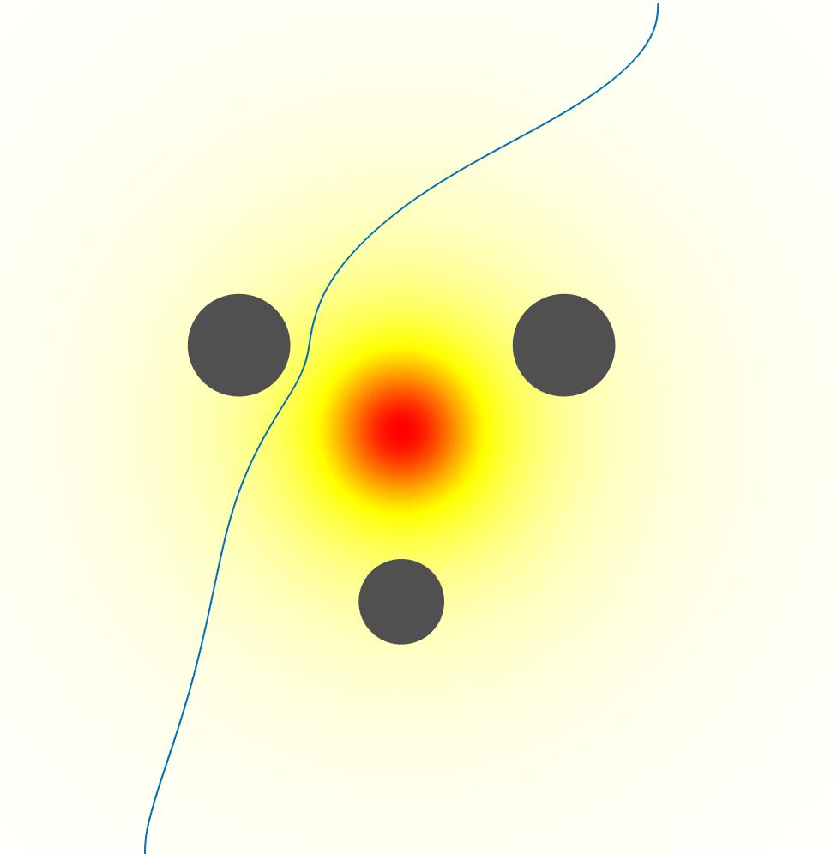

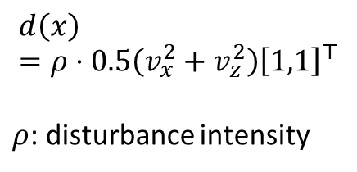
Simulation Setup
Planar rotor:
$\dot{x}=\left[\begin{matrix}{\dot{p}}_{x} \\ {\dot{p}}_{z} \\ \begin{aligned}\dot{φ} \\ {\dot{v}}_{x} \\ {\dot{v}}_{z} \\ \ddot{φ}\end{aligned}\end{matrix}\right]= d(x))\left[\begin{matrix}v_{x}\cos\left(φ\right)−v_{z}\sin\left(φ\right) \\ v_{x}\sin\left(φ\right)+v_{z}\cos\left(φ\right) \\ \begin{aligned}\dot{φ} \\ v_{z}\dot{φ}−gsin\left(φ\right) \\ −v_{x}\dot{φ}−g\text{cos}\left(φ\right) \\ 0\end{aligned}\end{matrix}\right]+ \left[\begin{matrix}0 & 0 \\ 0 & 0 \\ \begin{aligned}0 \\ 0 \\ \frac{1}{m} \\ \frac{l}{J}\end{aligned} & \begin{aligned}0 \\ 0 \\ \frac{1}{m} \\ −\frac{l}{J}\end{aligned}\end{matrix}\right](u+d(x)),$
$$d\left(x\right)=ρ⋅0.5\left(v_{x}^{2}+v_{z}^{2}\right){\left[1,1\right]}^{⊤}$$
$ρ$: disturbance intensity
 | Start – End | Actual Start
Task 1 | (2,0) – (8,10) | (0,0)
Task 2 | (8,0) – (2,10) | (10,0)
Task 3 | (0,6) – (10,6) | (0,4)

Slide 17
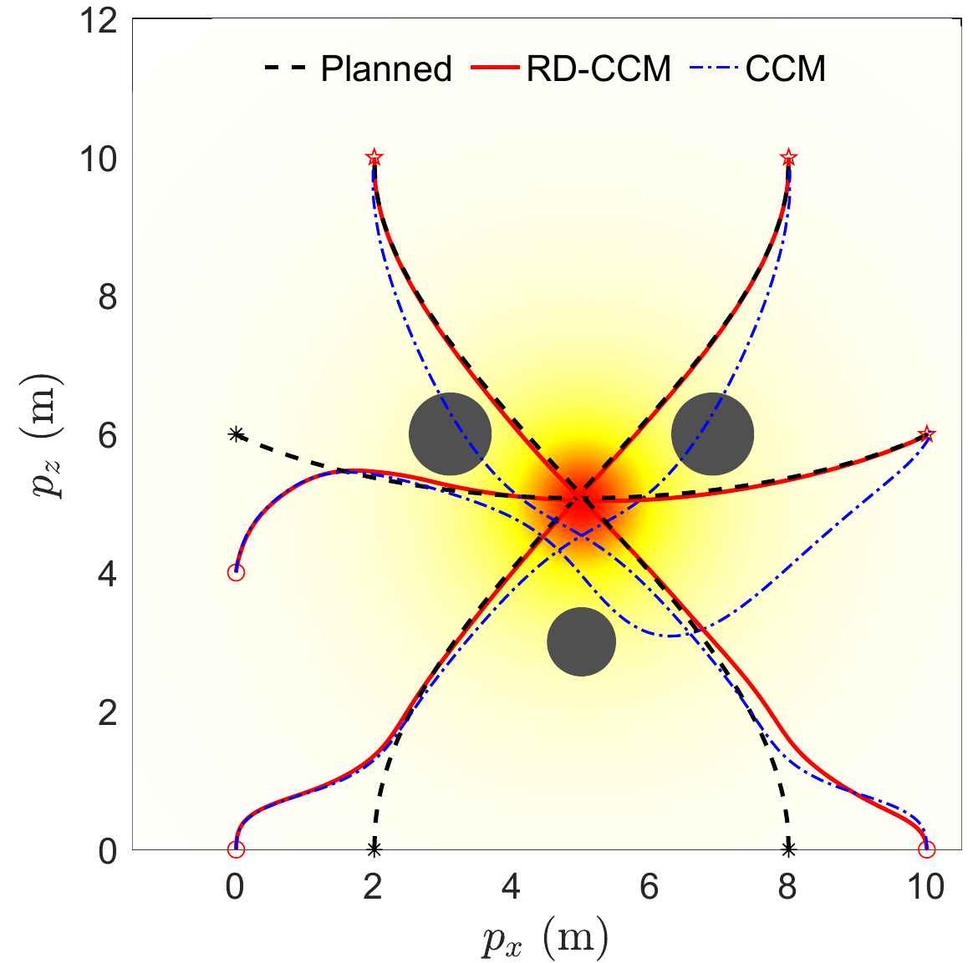
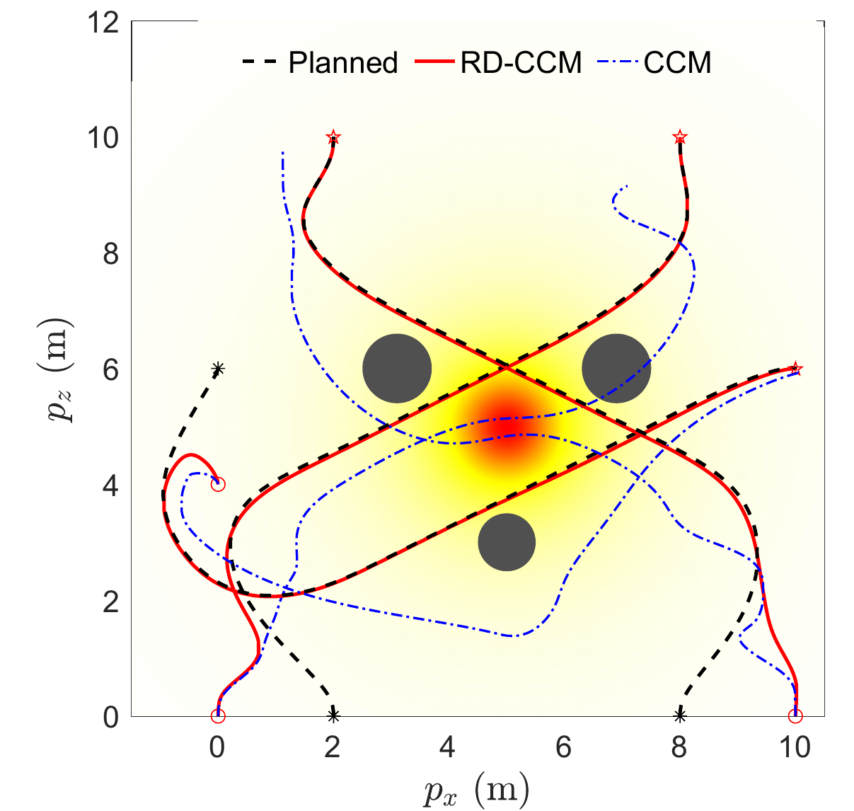
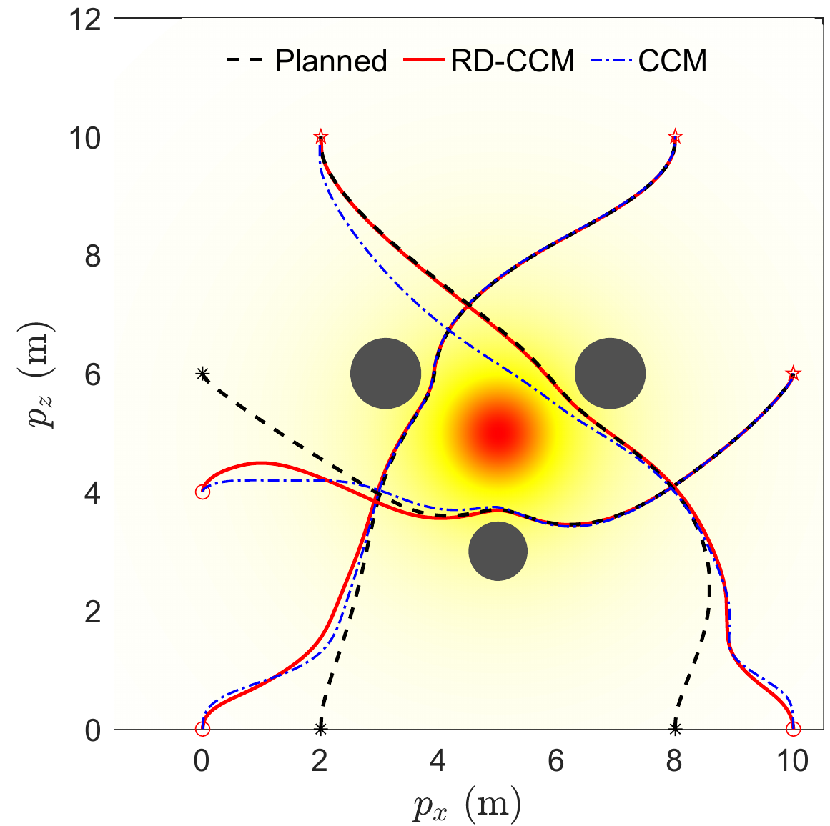
Simulation Results
Trajectory planning and tracking with learned disturbance.
No Learning
Moderate Learning
Good Learning

Slide 18
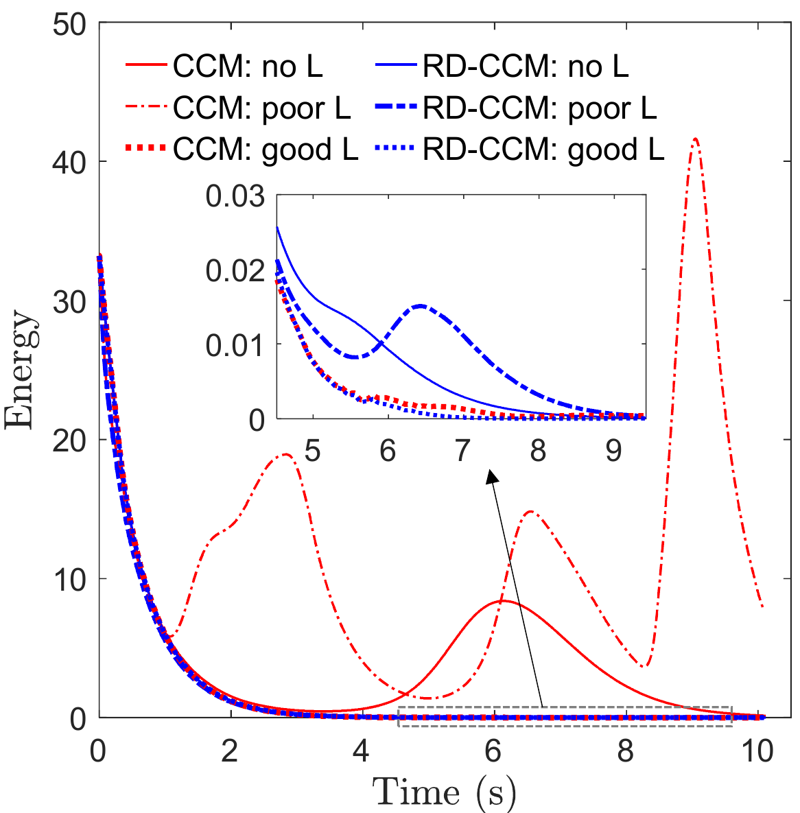
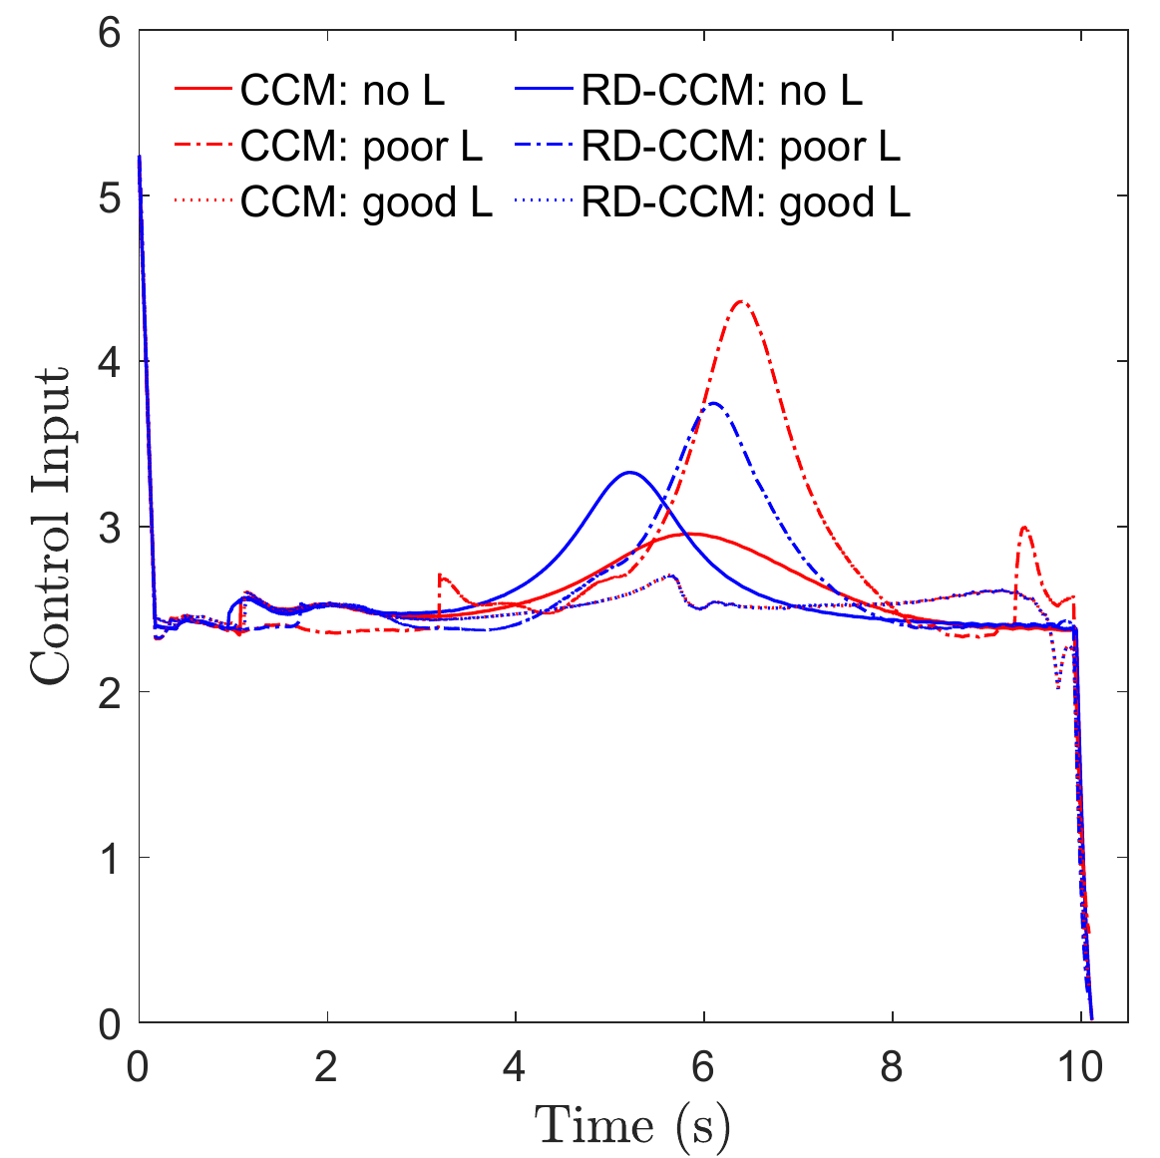
Simulation Results
Riemannian Energy
Control Input

Slide 19
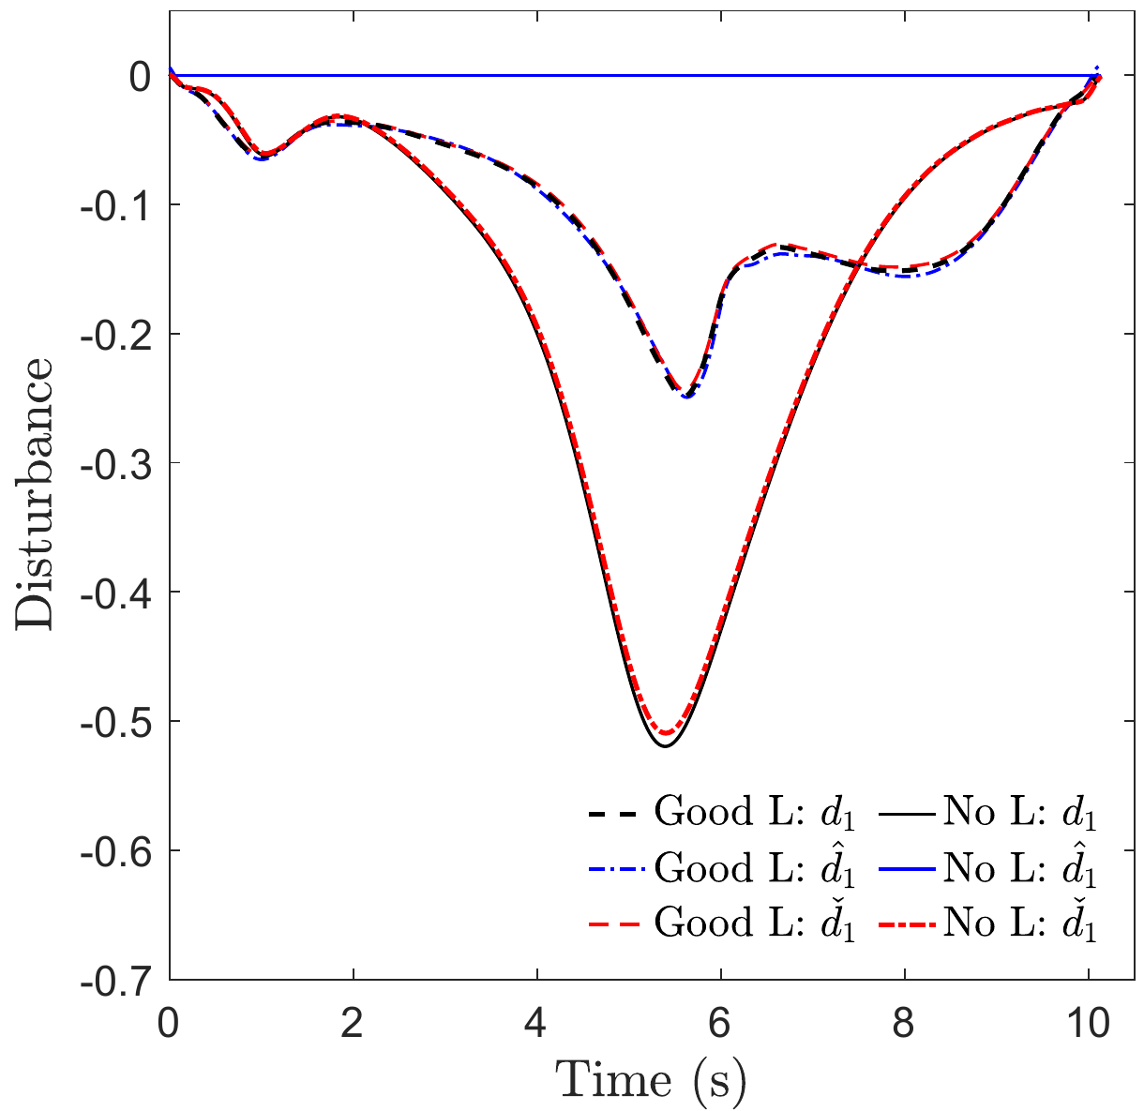
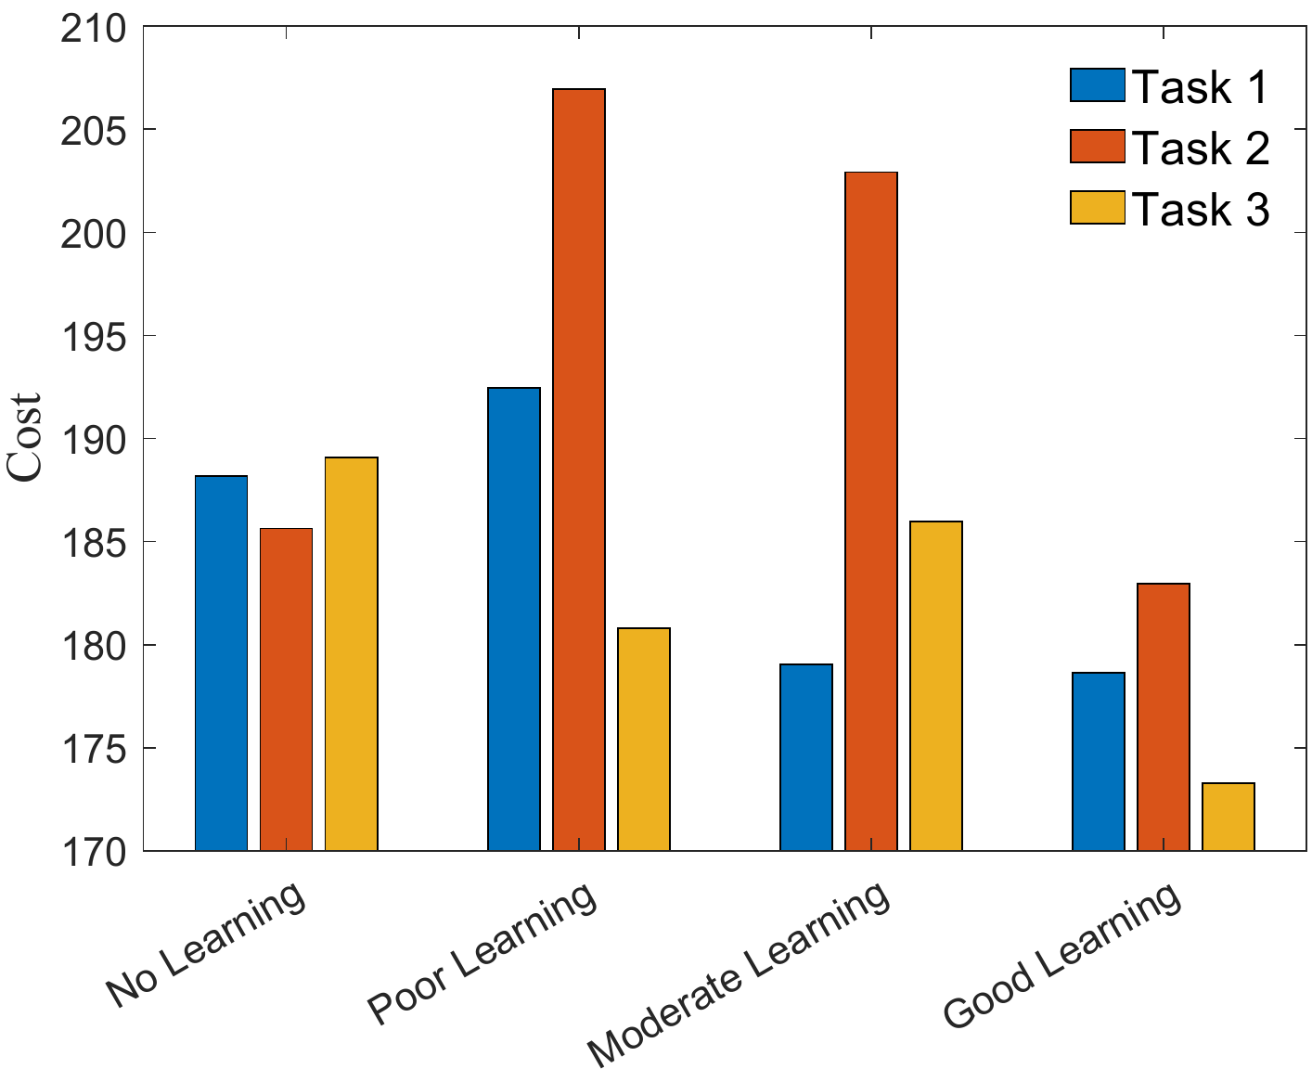
Simulation Results
Disturbance Encountered
Costs of the Actual Trajectories

Slide 20
Summary
We propose a trajectory-centric learning control framework based on contraction metrics and disturbance estimation for uncertain nonlinear systems.
The framework allows for the use of a broad class of model learning tools, such as deep neural networks (DNNs), to learn uncertain dynamics, while still providing guarantees of transient tracking performance in the form of exponential convergence of actual trajectories to desired ones throughout the learning phase, including the special case of no learning.
With improved accuracy, the learned model can help plan better trajectories with improved performance beyond tracking.

Slide 21
Questions?

Slide 22
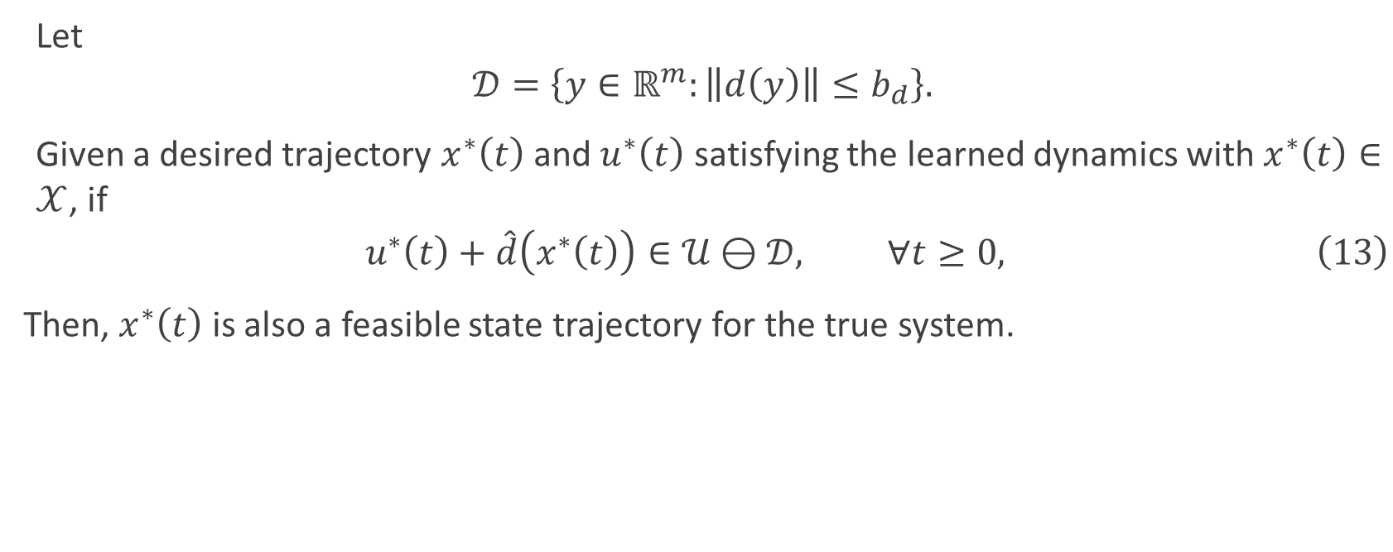
Feasible Trajectory for the True System
Let
$$𝒟=\left\{y∈ℝ^{m}:\left\|d\left(y\right)\right\|≤b_{d}\right\}.$$
Given a desired trajectory $x^{∗}\left(t\right)$ and $u^{∗}\left(t\right)$ satisfying the learned dynamics with $x^{∗}\left(t\right)∈𝒳$, if
$$u^{∗}\left(t\right)+\hat{d}\left(x^{∗}\left(t\right)\right)∈𝒰⊖𝒟, ∀t≥0, \left(13\right)$$
Then, $x^{∗}\left(t\right)$ is also a feasible state trajectory for the true system.

